Slide 1
Vegetation analysis of fire-affected region in the context of land management
By Brooke Hunter and Jon Sheppard

Slide 2
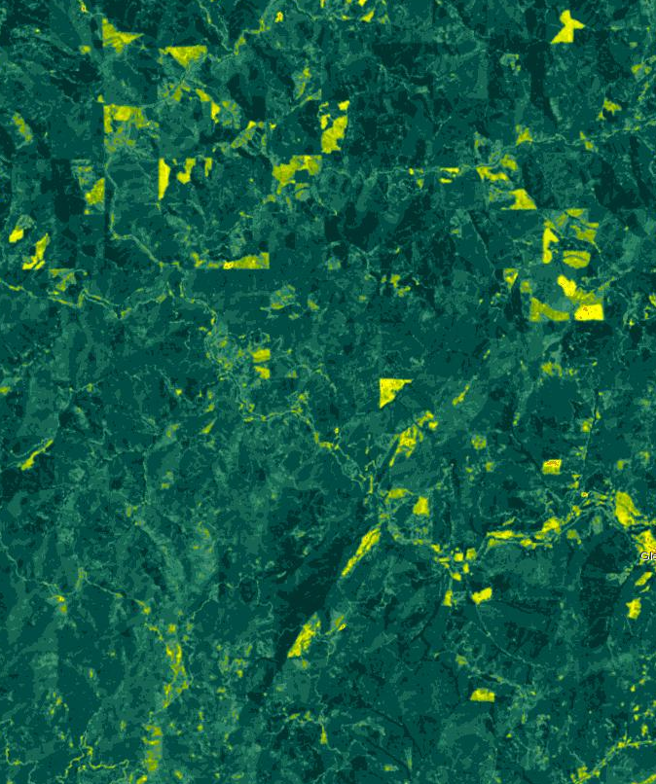
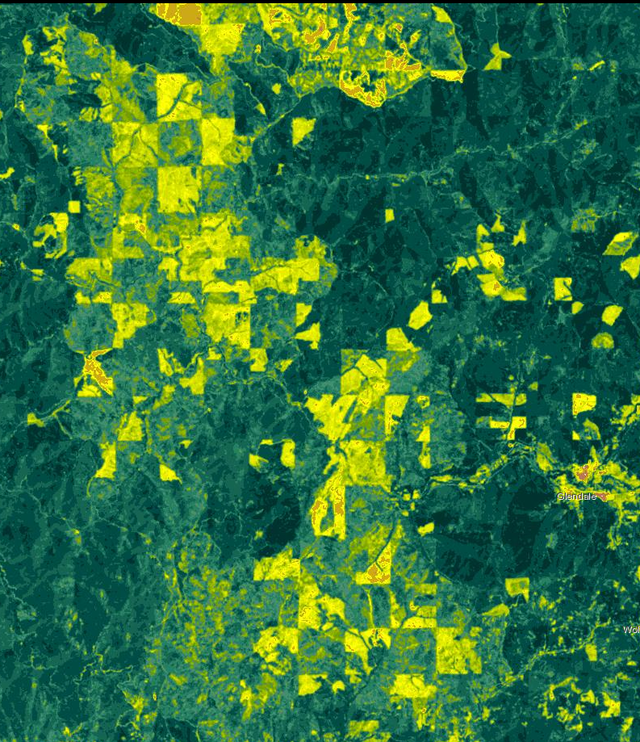
Douglas Fire Complex (2013)
5 km
Pre-fire 2013
July 20th, 2019
Images from Esri Landsat Live Viewer

Slide 3
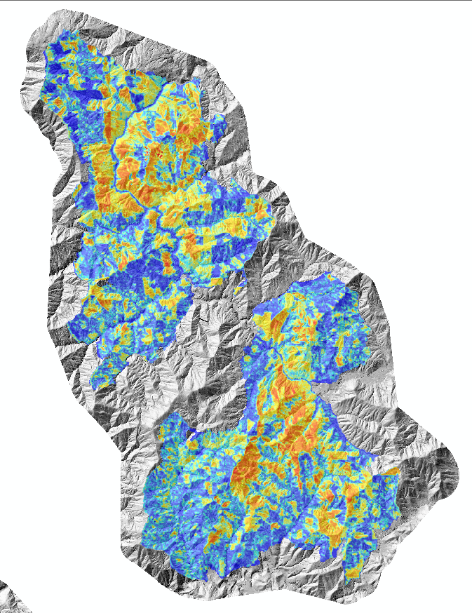
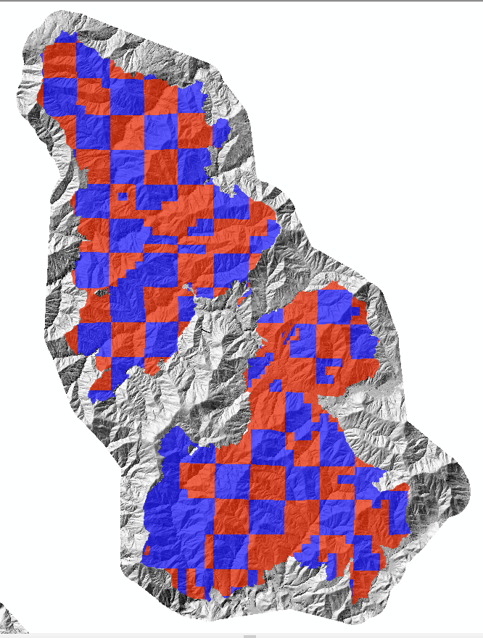
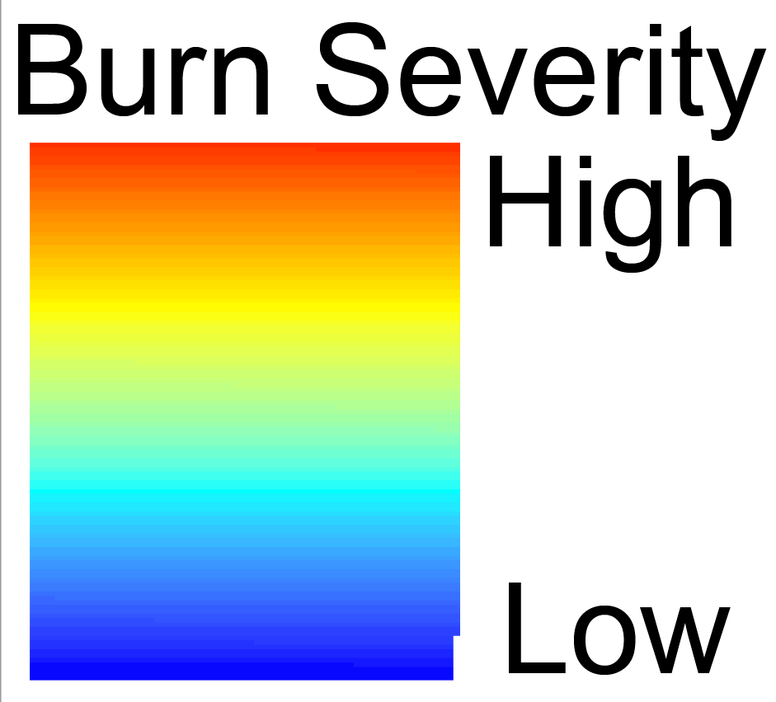
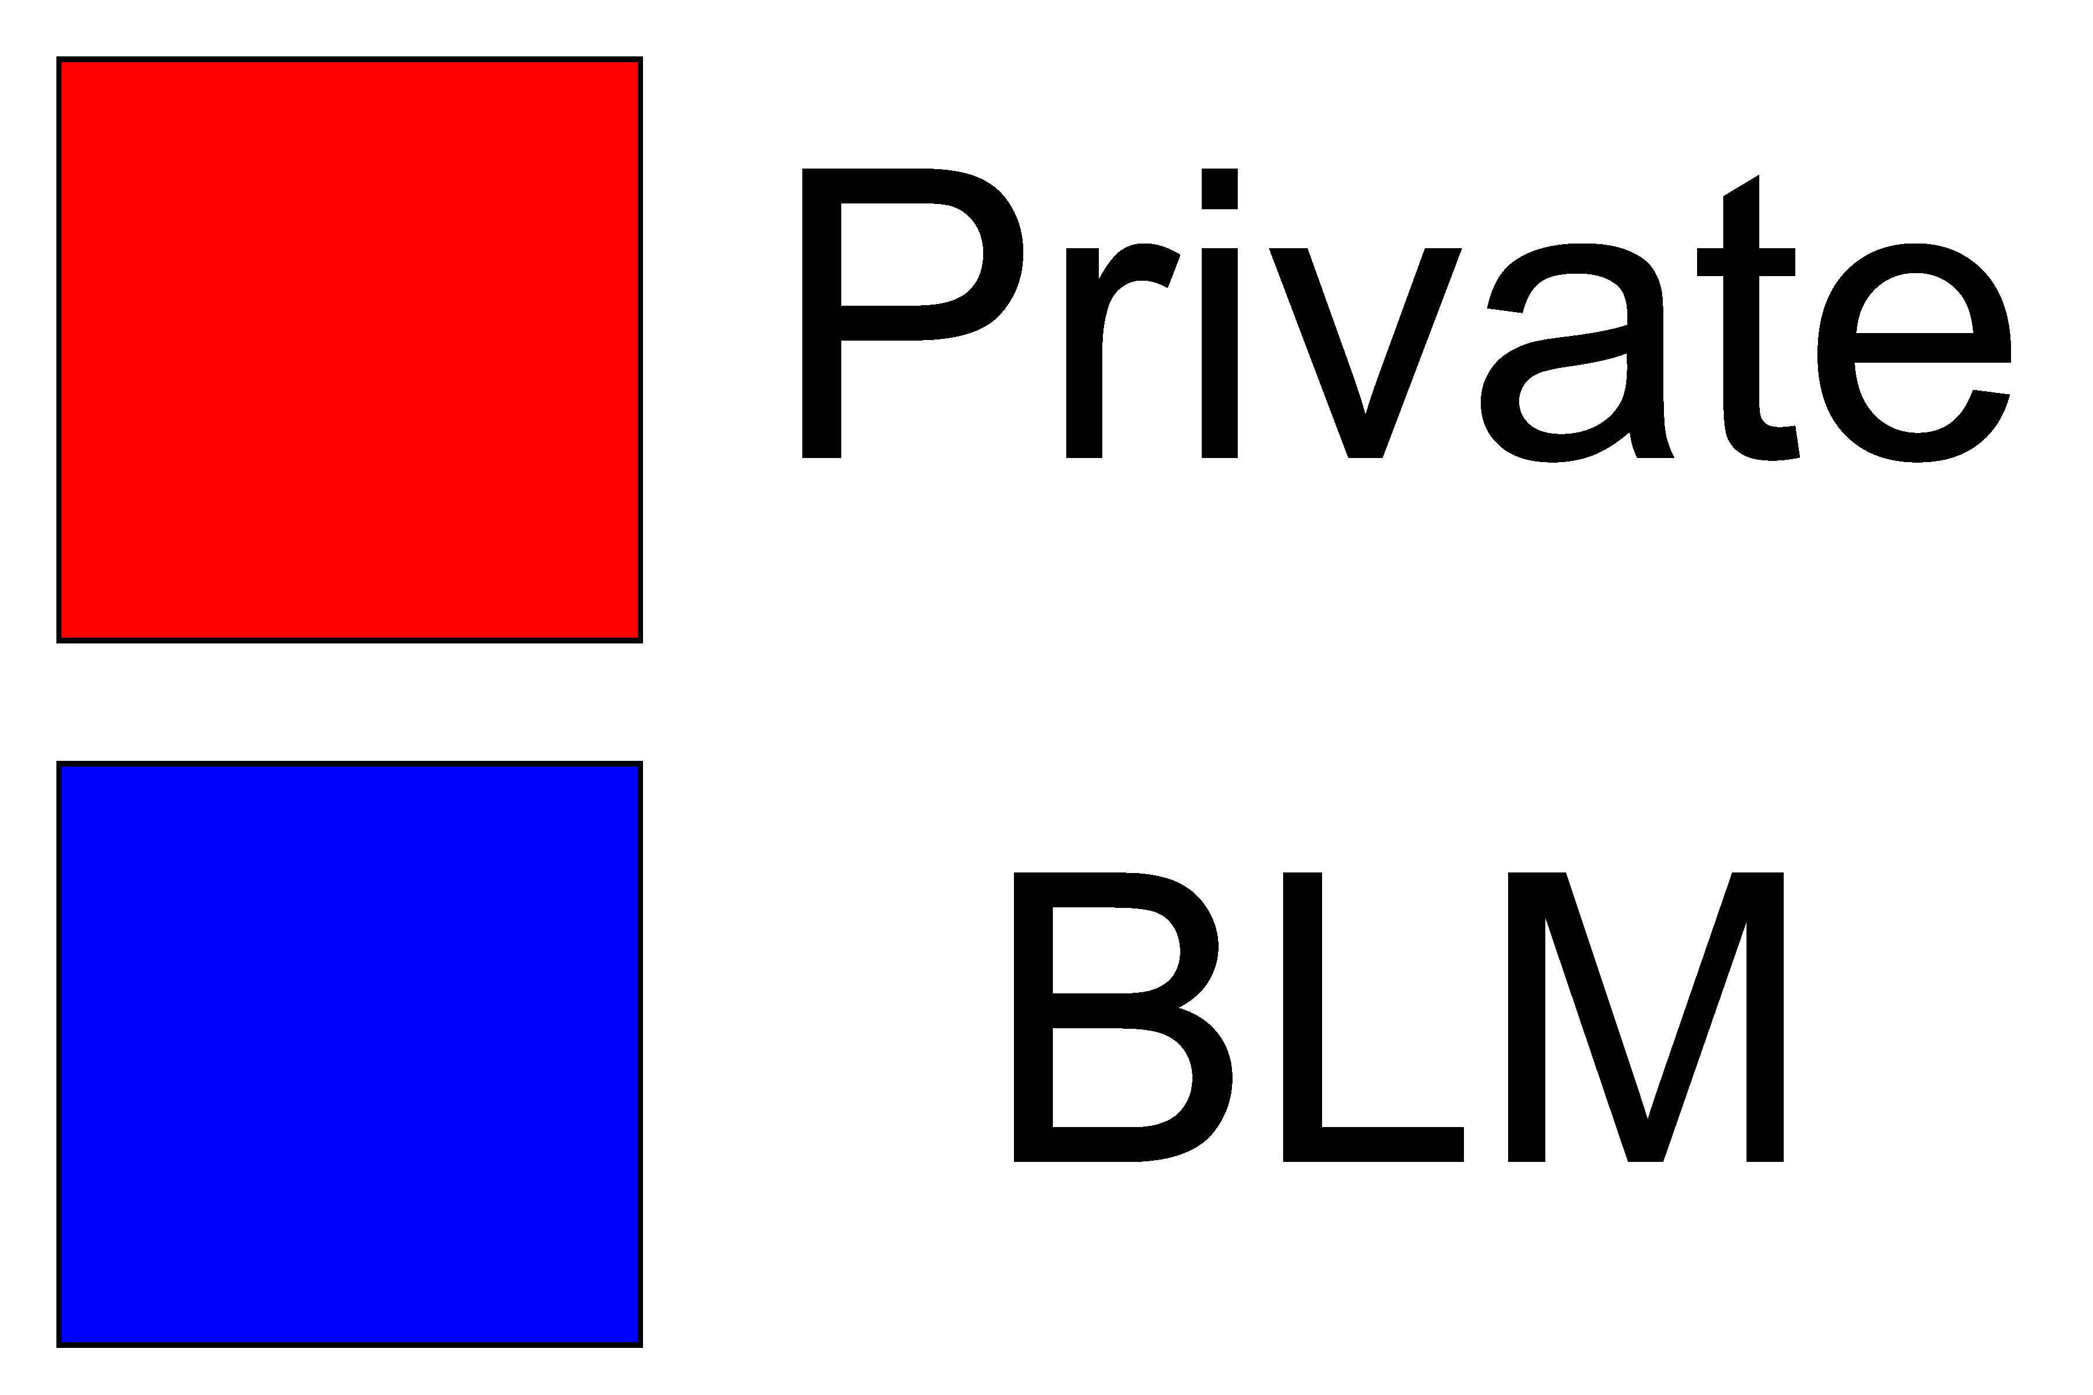
Motivation
Wildfire frequency and intensity has increased in recent years.
In Oregon, a checkerboard of privately and publicly owned land has resulted in a landscape that has sharp boundaries between clear cut and vegetated regions.
Vegetation can be important to hillslope recovery
Zald and Dunn 2018
Notes:
Problem statement

Slide 4
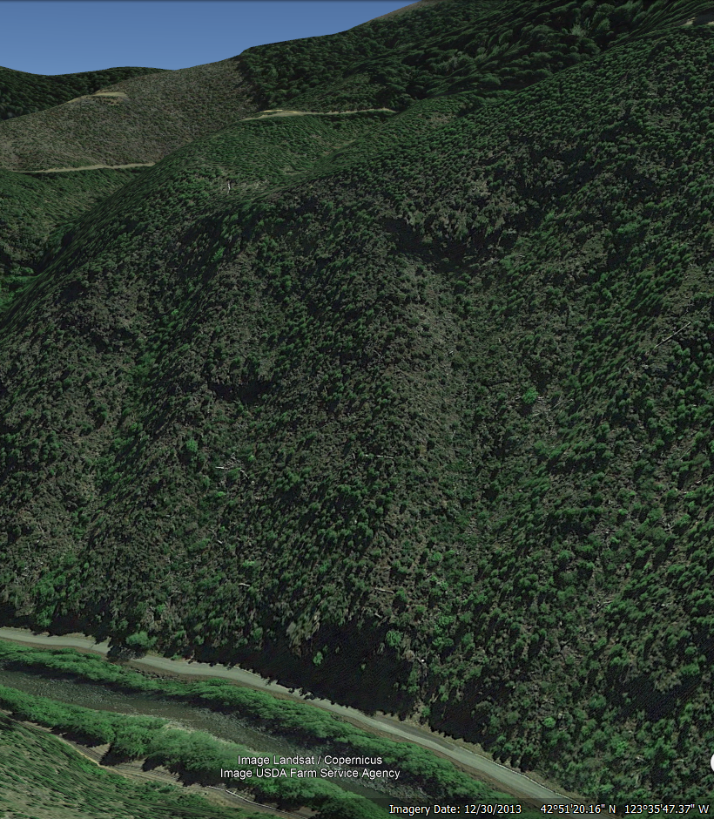
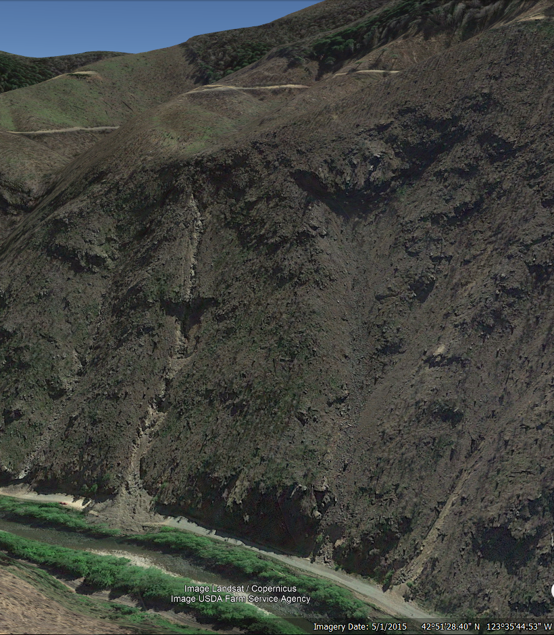
Motivation
Wildfire frequency and intensity has increased in recent years.
In Oregon, a checkerboard of privately and publicly owned land has resulted in a landscape that has sharp boundaries between clear cut and vegetated regions.
Vegetation can be important to hillslope recovery
Pre-Douglas Fire 2013
Post-Douglas Fire 2015
Notes:
Problem statement

Slide 5
Goal and Questions
Our project we aim to investigate how this pattern of private and public land management influences vegetation recovery through normalized differenced vegetation index analysis (NDVI) over time pre and post-fire.
How quickly does vegetation recover after wildfires?
How does recovery vary based on land management practices? .
Methods
We will calculate normalized differenced vegetation index (NDVI) for pre-and post-fire landsat data to investigate vegetation recovery of the Douglas Fire (July 2013).
We will separate this analysis based on land ownership separate by private (Roseburg Timber) and publicly (Bureau of Land Management) land.

Slide 6
Methodology: Datasets
Landsat 7-8 imagery 2012-2022 (Google Earth Engine): 30% cloud cover. 99 images
Douglas Complex Fire (2013) .tif file (Zald and Dunn 2018)
Land Status Oregon ownership (BLM arc services): 1 (white) = private, 0 (black) = BLM

Slide 7
Methodology: Tools
Google Earth Engine: Landsat images
gdal: convert Douglas fire extent .tif and land status .tif to match crs of Landsat images (ESPG: 32610) and pad their spatial extents to match Landsat images
Jupyter Lab: manipulation and analysis of data after downloading and using gdal from command line

Slide 8
Methodology: Workflow
Query Landsat Collection through Google Earth Engine via Google Collab.
Calculate Normalized Difference Vegetation Index (NDVI) of each image.
Convert Douglas Fire extent and ownership tifs to ESPG: 32610.
Pad Douglas Fire and ownership tifs to match Landsat spatial extent.
Subset and clip NDVI images based on Douglas Fire extent .tif file.
Subset newly clipped NDVI images based on a binary ownership file.
Analyze trends in the resulting data with boxplot and mean values.

Slide 9
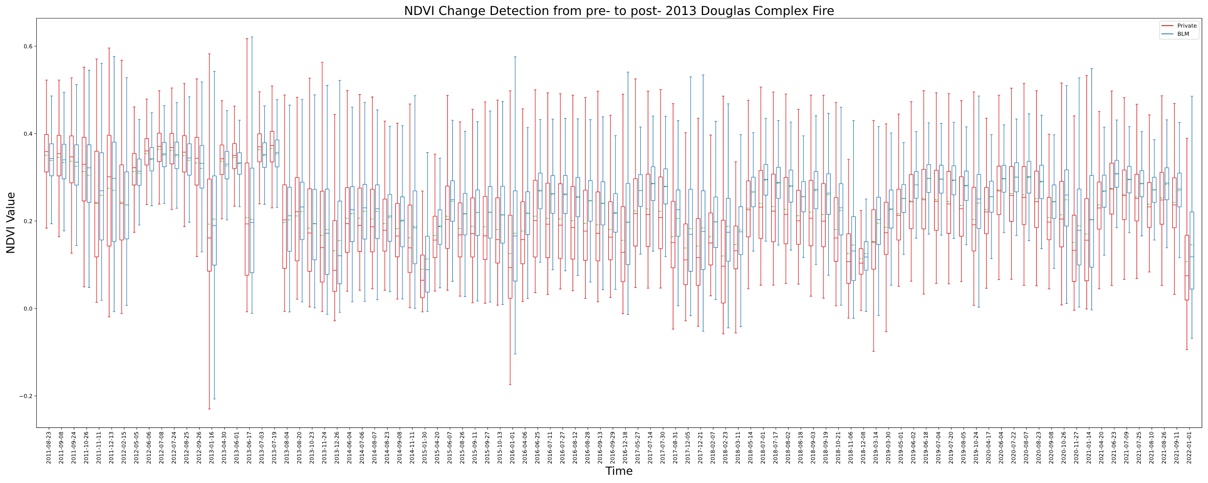
Results: Boxplots

Slide 10
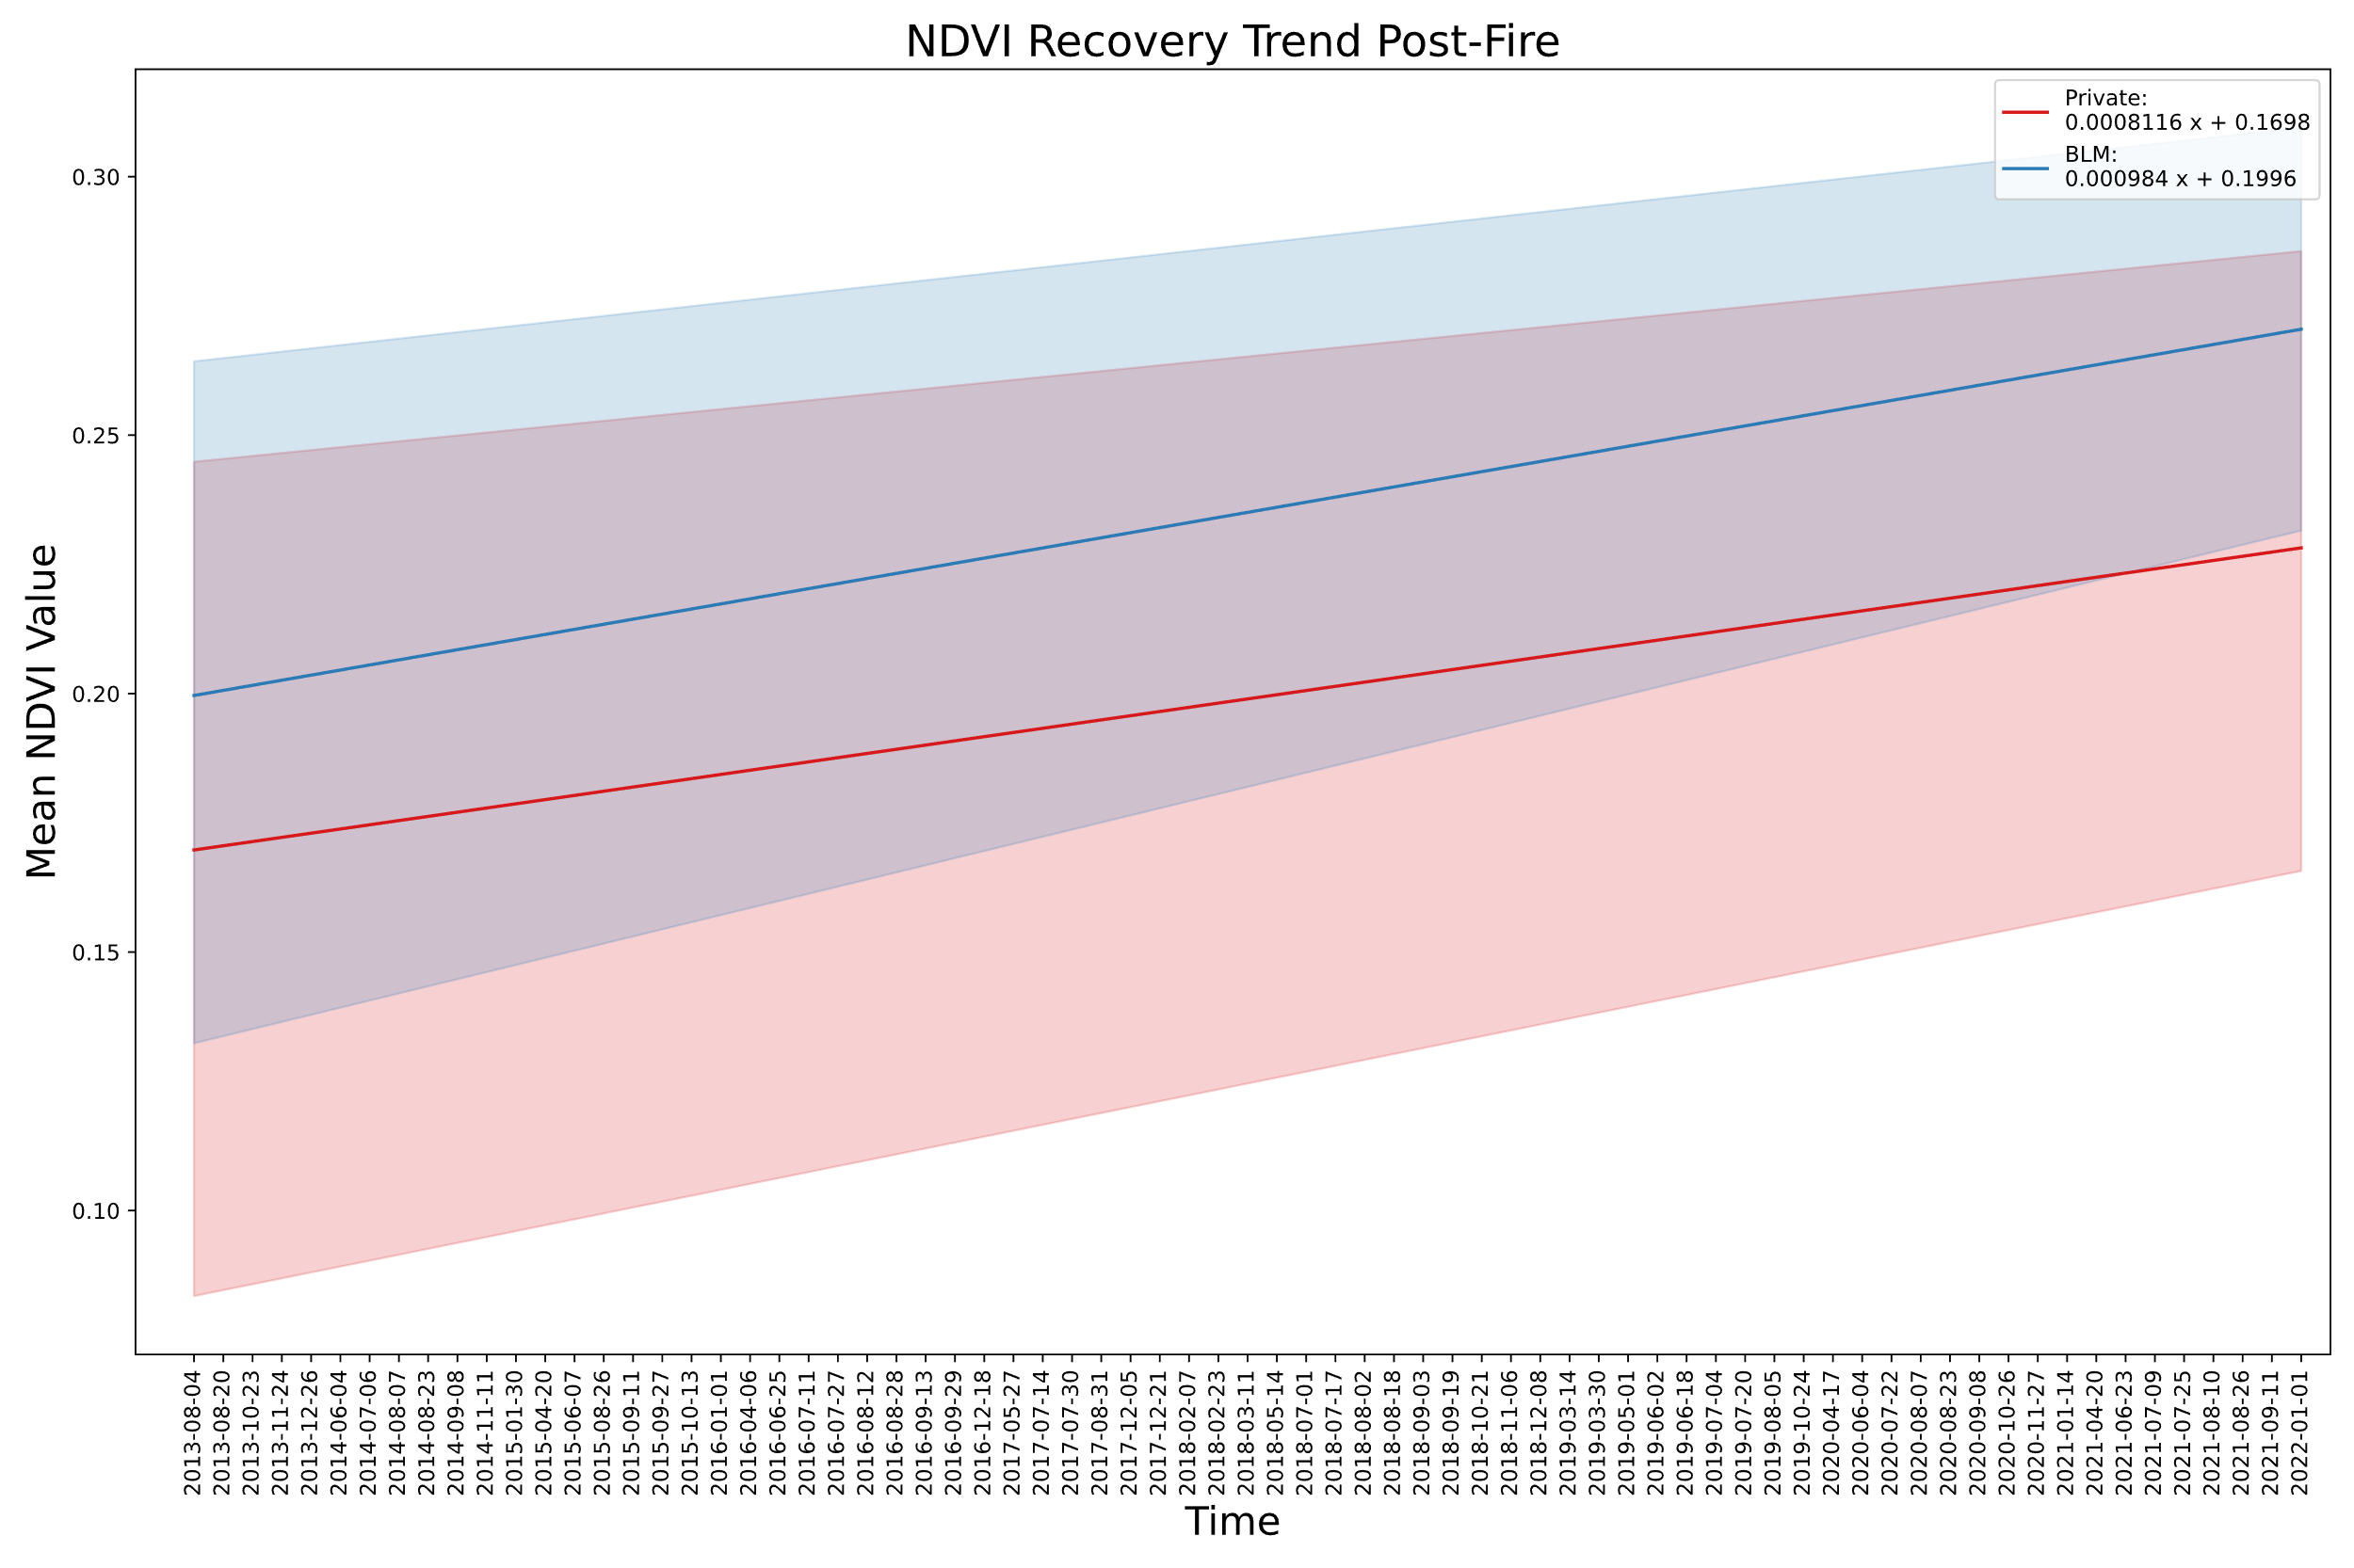
Results: Post-fire Mean NDVI Trendlines

Slide 11
Results: Percent Recovery (June)

Slide 12
Discussion
Land managed by the BLM has a greater recovery rate, and a decreasing interquartile range
Private land salvaged logged after the fire.

Slide 13
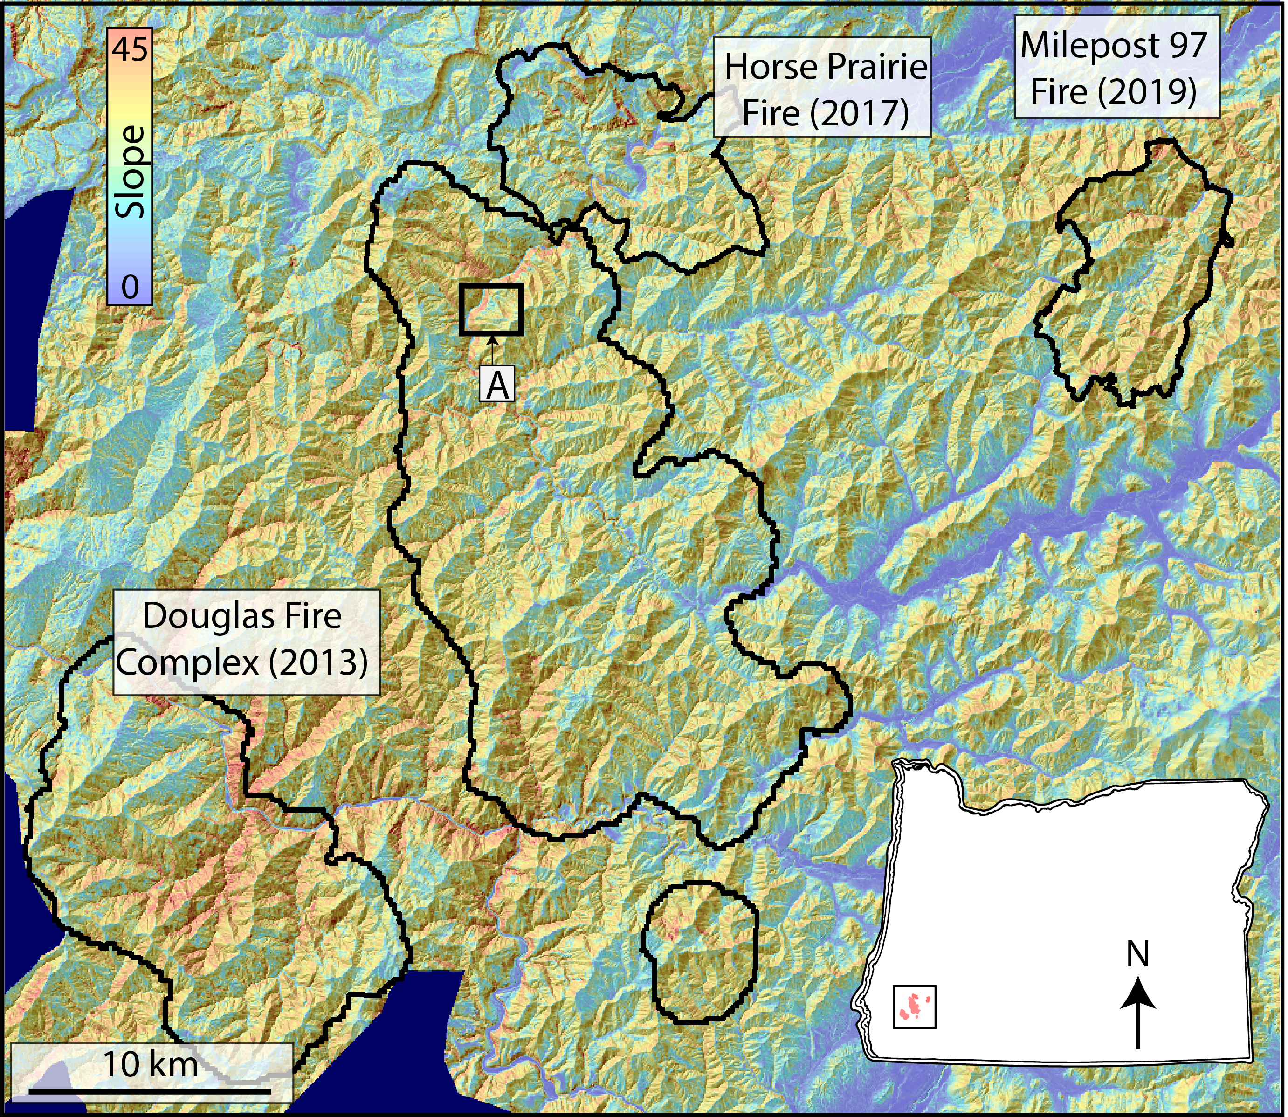
Further Steps & Questions
Apply to more fires (there are plenty in the area)
Separate land management further than just private and BLM. Or connect to “time since salvage logging”
Account for serial correlation (seasonality)
Connect to Brooke’s LiDAR change detection project

Slide 14
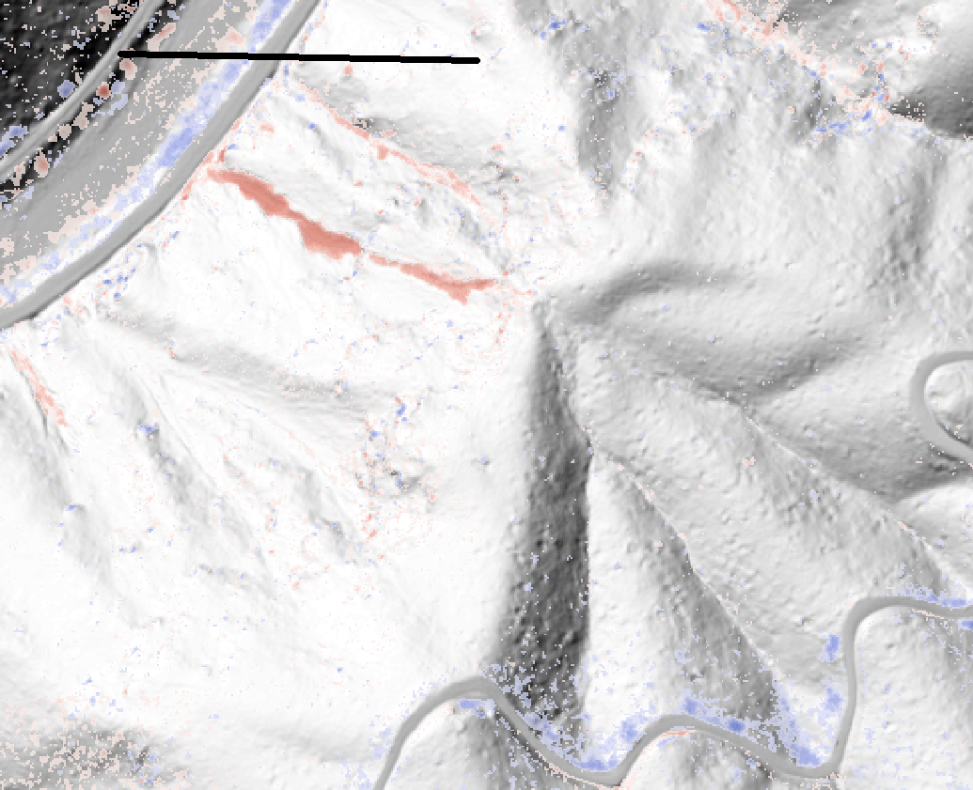
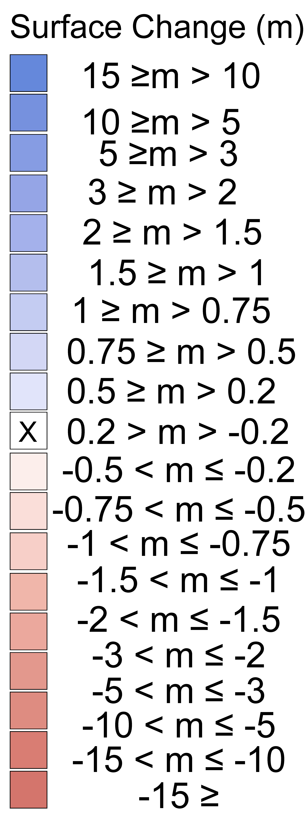
Further Steps & Questions
Apply to more fires (there are plenty in the area)
Separate land management further than just private and BLM. Or connect to “time since salvage logging”
Account for serial correlation (seasonality)
Connect to Brooke’s LiDAR change detection project
200 meters
2013- 2015
DEM of difference ( DoD)

Slide 15
References and Links
https://github.com/bhunter2/PostFire_NDVI

